Slide 1

Introduction
The Consumer Complaints Project compiles and analyzes data related to grievances lodged by customers against various financial institutions. The data spans different products like mortgages, credit cards, and loans, detailing issues and sub-issues, complaint narratives, company responses, and complaint statuses across multiple states

Slide 2

Objective
The primary objective of the project is to understand the nature and frequency of the consumer complaints, identify patterns or trends in the data, and evaluate the responsiveness of companies to these complaints. It involves data cleaning to remove duplicates and handling missing values, data wrangling to categorize issues, and analysis such as calculating the time taken for complaints to be delivered to companies

Slide 3

Visualization

Slide 4

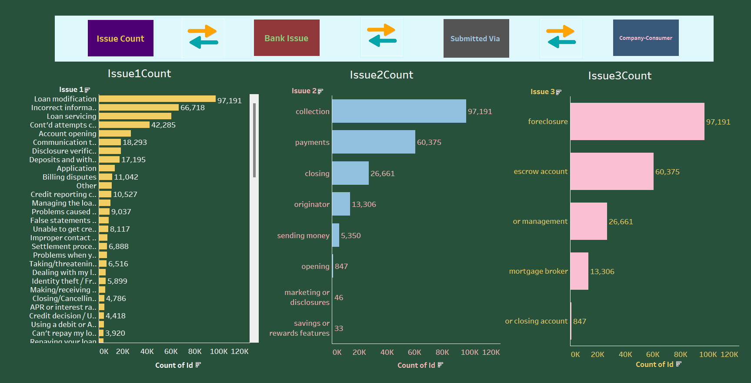
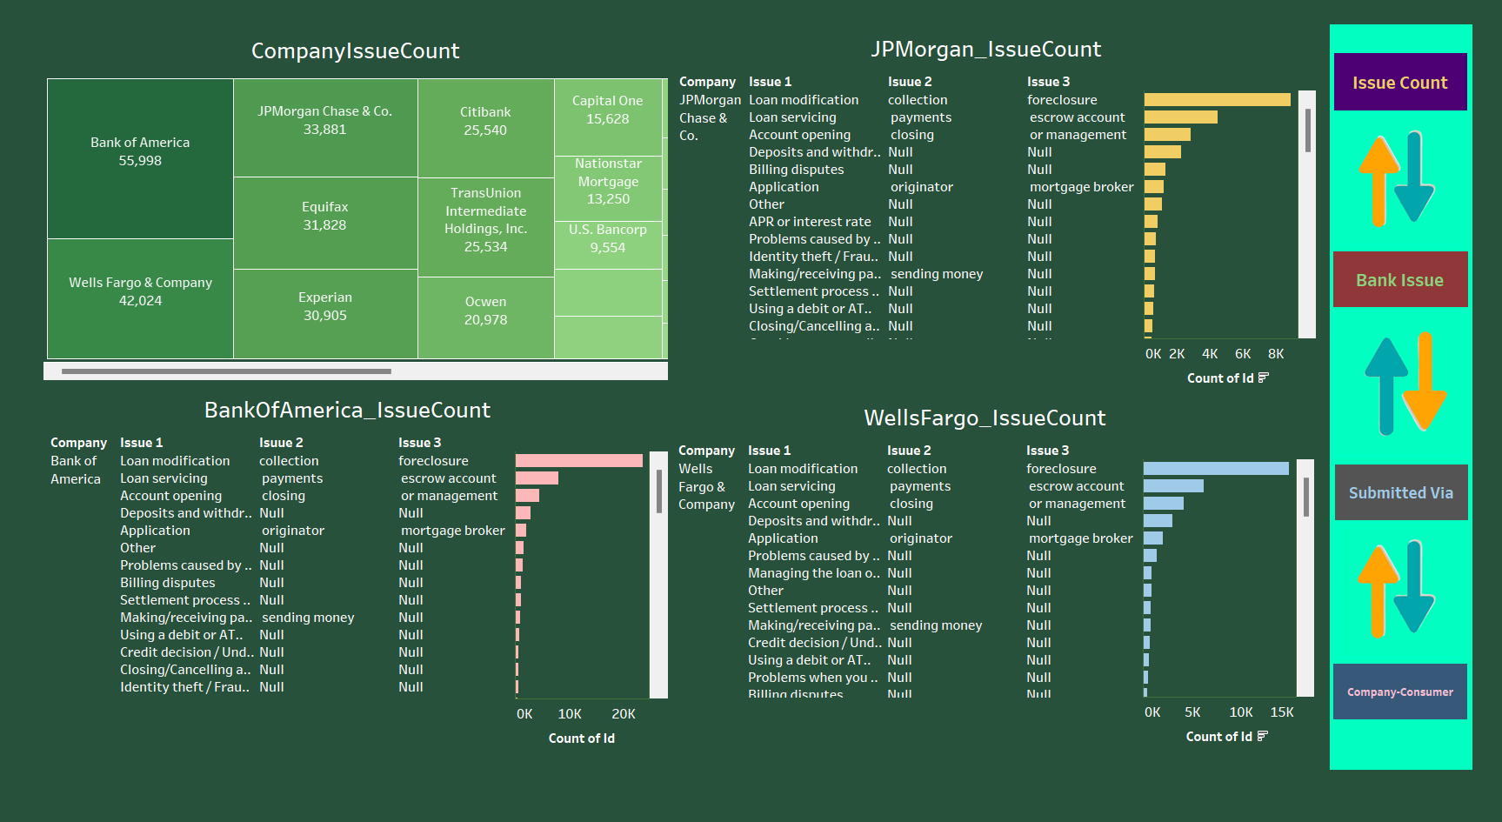
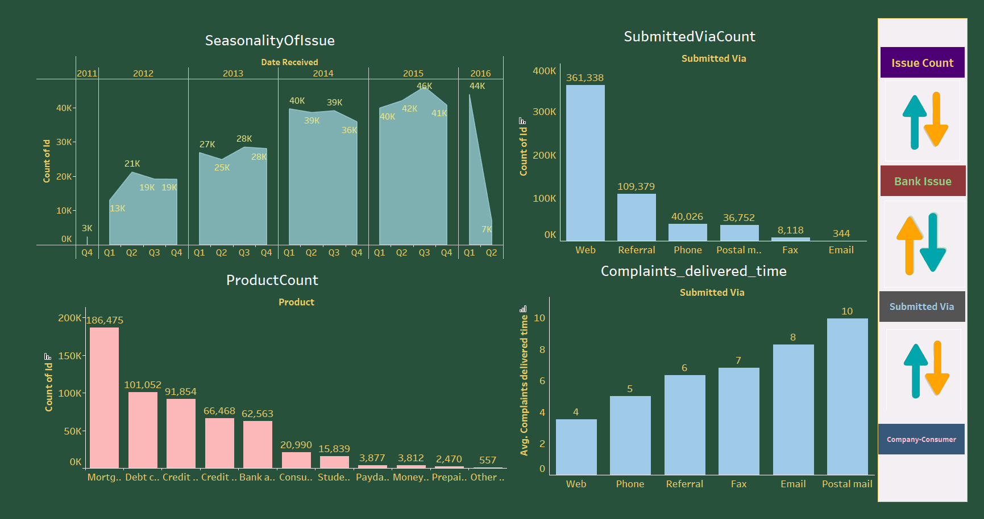
The dashboard shows data on consumer complaints categorized into three main issues:
Issue1Count: The most common complaint is about "Loan modification/foreclosure" with 97,191 cases, followed by "Incorrect information on credit report" with 66,718 complaints. The least complaints are related to "Repaying your loan" at 3,920.
Issue2Count: Here again, "Collection" leads with 97,191 complaints, "Payments" come next with 60,375, while the least are "Savings or rewards features" at 33 complaints.
Issue3Count: Mimics the first chart with "Foreclosure" at the top with 97,191 complaints, followed by "Escrow account" with 60,375. The lowest are for "Mortgage broker" at 13,306

Slide 5

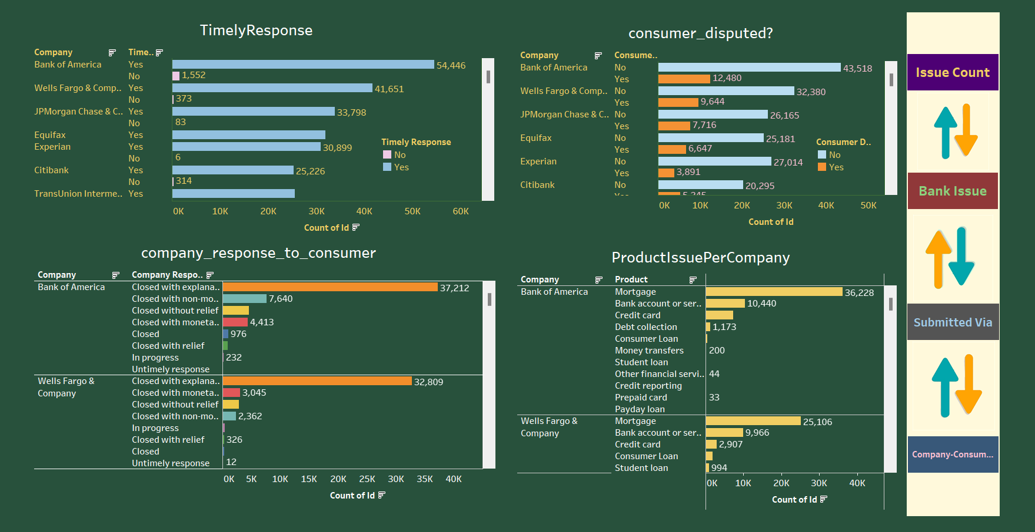
The dashboard displays consumer complaint counts for various companies and categorizes the issues into three main types.
CompanyIssueCount: Bank of America has the highest number of complaints at 55,998, followed by Wells Fargo & Company at 42,024, and JPMorgan Chase & Co. at 33,881. Equifax and Experian are the credit bureaus with significant complaint counts.
Individual Company Issues:
For Bank of America, the primary issues are "Loan modification," "Loan servicing," and "Foreclosure" with no data for Issue 2 and 3 categories.
JPMorgan Chase & Co. shows a large number of "foreclosure" complaints and several other issues with no data for Issue 2 and 3.
Wells Fargo & Company similarly has "Loan modification," "Loan servicing," and "Foreclosure" as their top issues with no data for Issue 2 and 3.

Slide 6

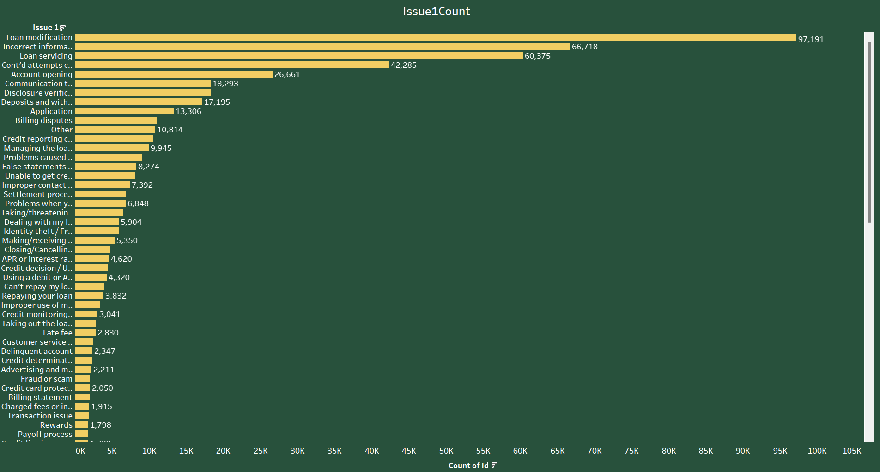
The dashboard visualizes data related to consumer complaints over time, their submission methods, and the products involved.
SeasonalityOfIssue: Shows a generally increasing trend in complaint counts from 2011 to 2015, with a peak in Q3 of 2015 at 46K complaints. There's a sharp drop to 7K in Q2 of 2016.
SubmittedViaCount: The majority of complaints were submitted via the web (361,338), followed by referral (109,379). The least used methods were fax and email.
ProductCount: Mortgages had the highest number of complaints (186,475), followed by debt collection and credit reporting. Payday loans, money transfers, prepaid cards, and others had the fewest complaints.
Complaints_delivered_time: It takes longer for complaints submitted via postal mail (10 days) to be delivered compared to other methods. Web and phone are quicker with 4 and 6 days, respectively

Slide 7

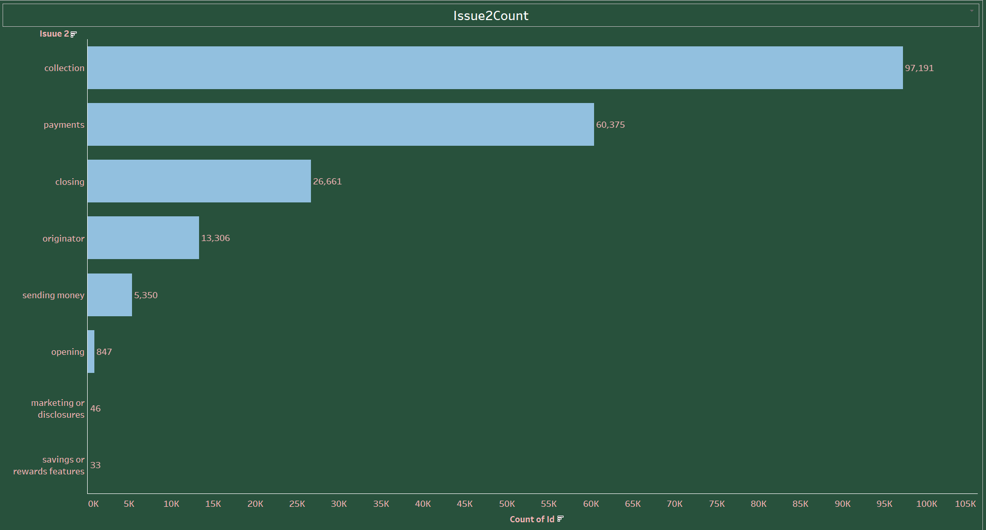
The dashboard displays various metrics regarding consumer complaints:
TimelyResponse: Wells Fargo & Company has the highest number of complaints with a timely response (41,651), whereas Equifax has the highest number of complaints without a timely response (30,899).
Company_response_to_consumer: For Bank of America, the majority of complaints were closed with explanation (37,212), and for Wells Fargo & Company, the most complaints were closed with explanation (32,809) as well.
Consumer_disputed?: Bank of America had many disputes not challenged by consumers (43,518 'No'), while Experian had a relatively high count of disputed complaints (27,014 'Yes').
ProductIssuePerCompany: For Bank of America, 'Mortgage' issues were most prevalent (36,228), while for Wells Fargo & Company, 'Mortgage' and 'Bank account or service' were common complaint subjects

Slide 8

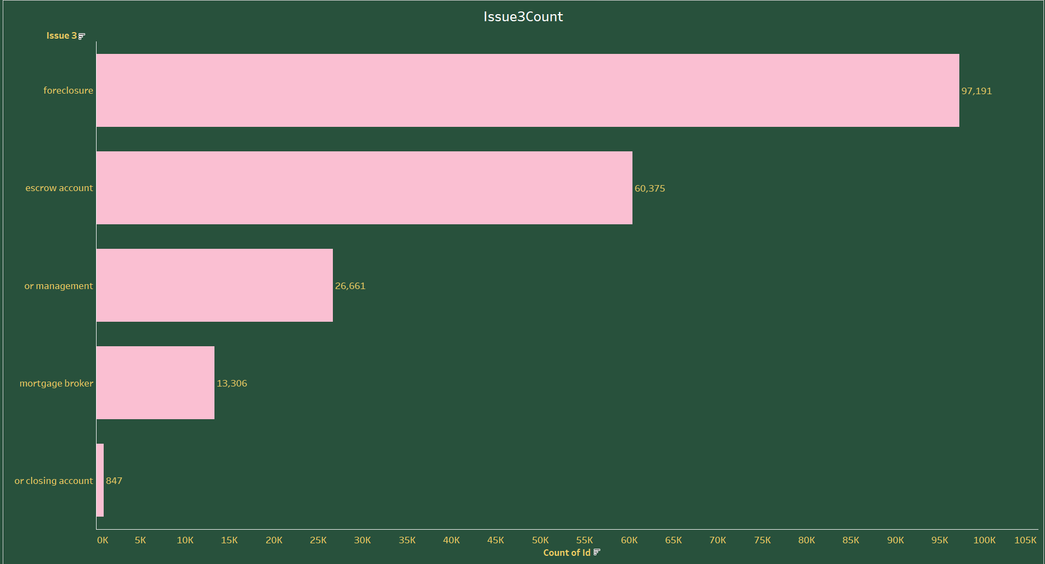
This chart details consumer complaints on various financial issues:
The most common complaint is regarding "Loan modification/foreclosure" with 97,191 cases.
"Incorrect information on credit report" follows with 66,718 complaints.
The least common are "Payoff process" and "Rewards" with 1,798 and 2,050 complaints, respectively.
The issues span a range of financial services, with the most serious concerns focused on loans and credit reporting. Complaints related to rewards programs and payoff processes are less frequent

Slide 9

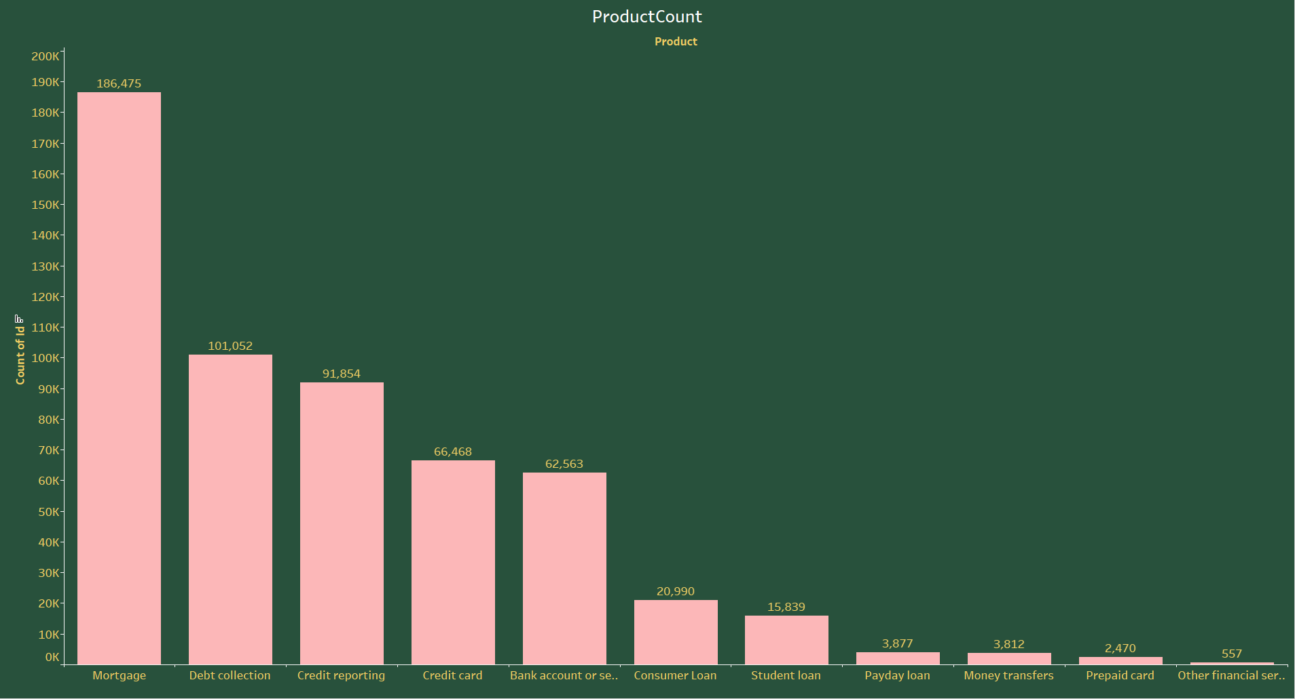
The chart visualizes Issue 2 complaints:
"Collection" complaints are the most numerous at 97,191.
"Payments" follow with 60,375 complaints.
"Marketing or disclosures" and "Savings or rewards features" have the least complaints at 46 and 33, respectively.
The chart suggests that "Collection" and "Payments" are major areas of concern for consumers in this set of issues

Slide 10

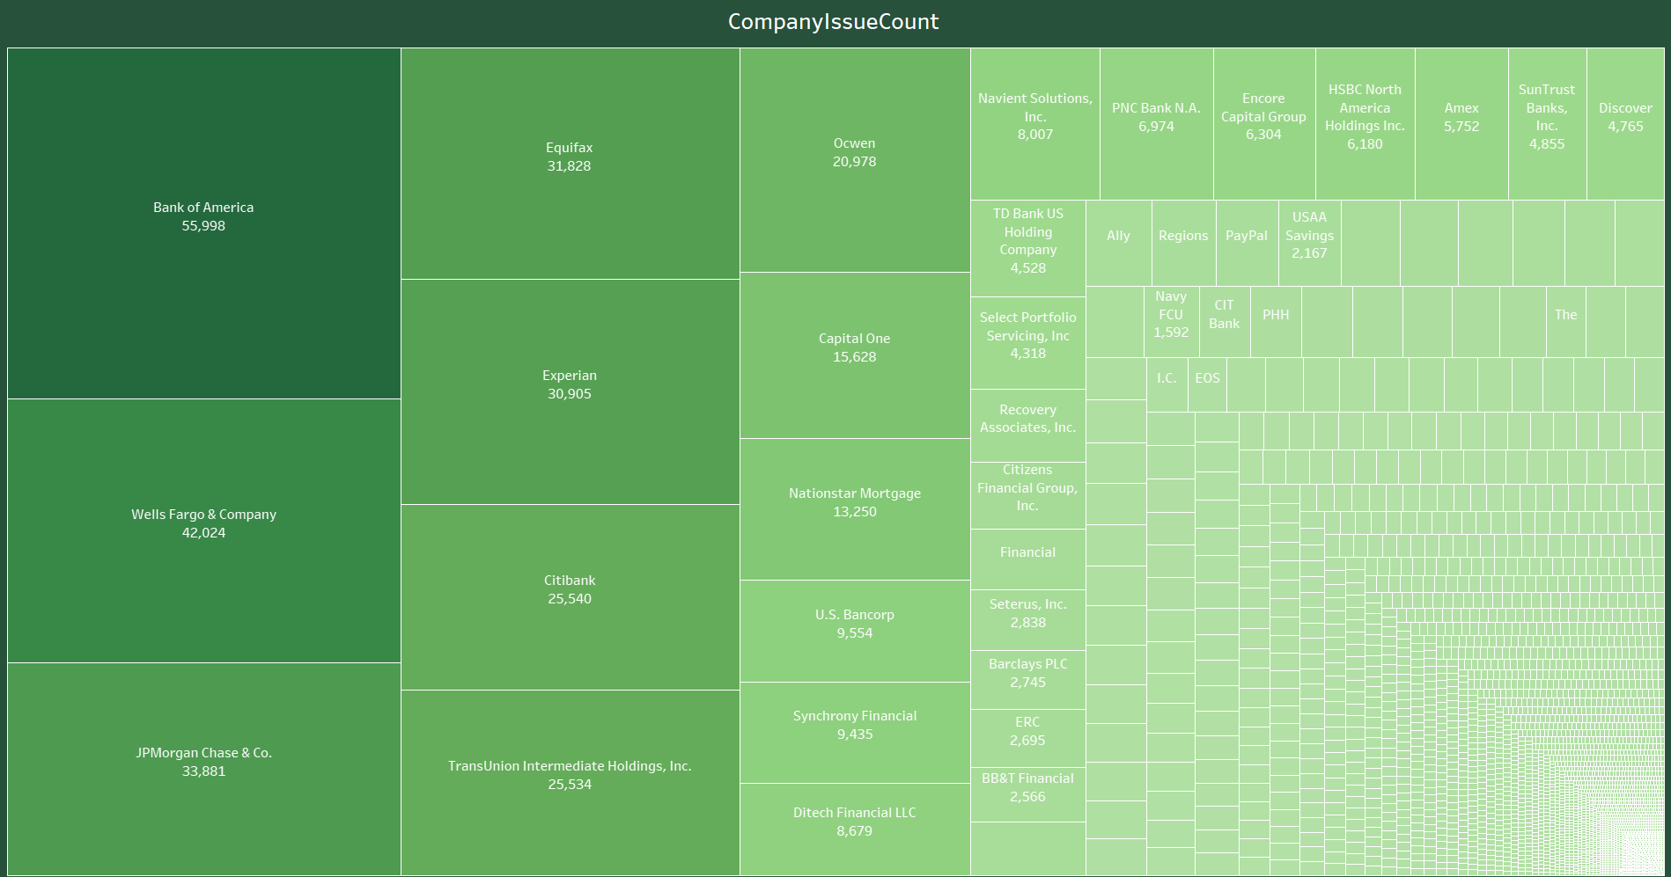
The chart outlines consumer complaints for a category designated as "Issue 3":
"Foreclosure" has the highest number of complaints with 97,191.
"Escrow account" complaints are the second-highest at 60,375.
The least complaints are about "Closing account" with 847.
This suggests "Foreclosure" and "Escrow account" issues are significant consumer concerns within this category

Slide 11

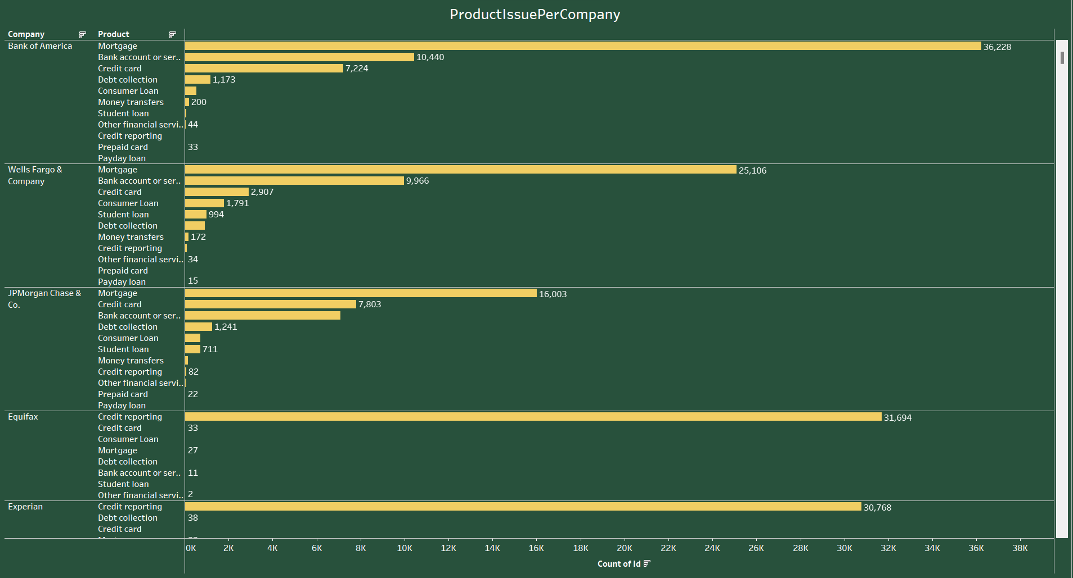
The chart provides a breakdown of consumer complaints by product type:
"Mortgage" has the highest number of complaints at 186,475.
"Debt collection" and "Credit reporting" are also significant categories with 101,052 and 91,854 complaints, respectively.
"Other financial services" has the least complaints at 557.
The data suggests that mortgages, debt collection, and credit reporting are primary areas of consumer concern in financial products

Slide 12

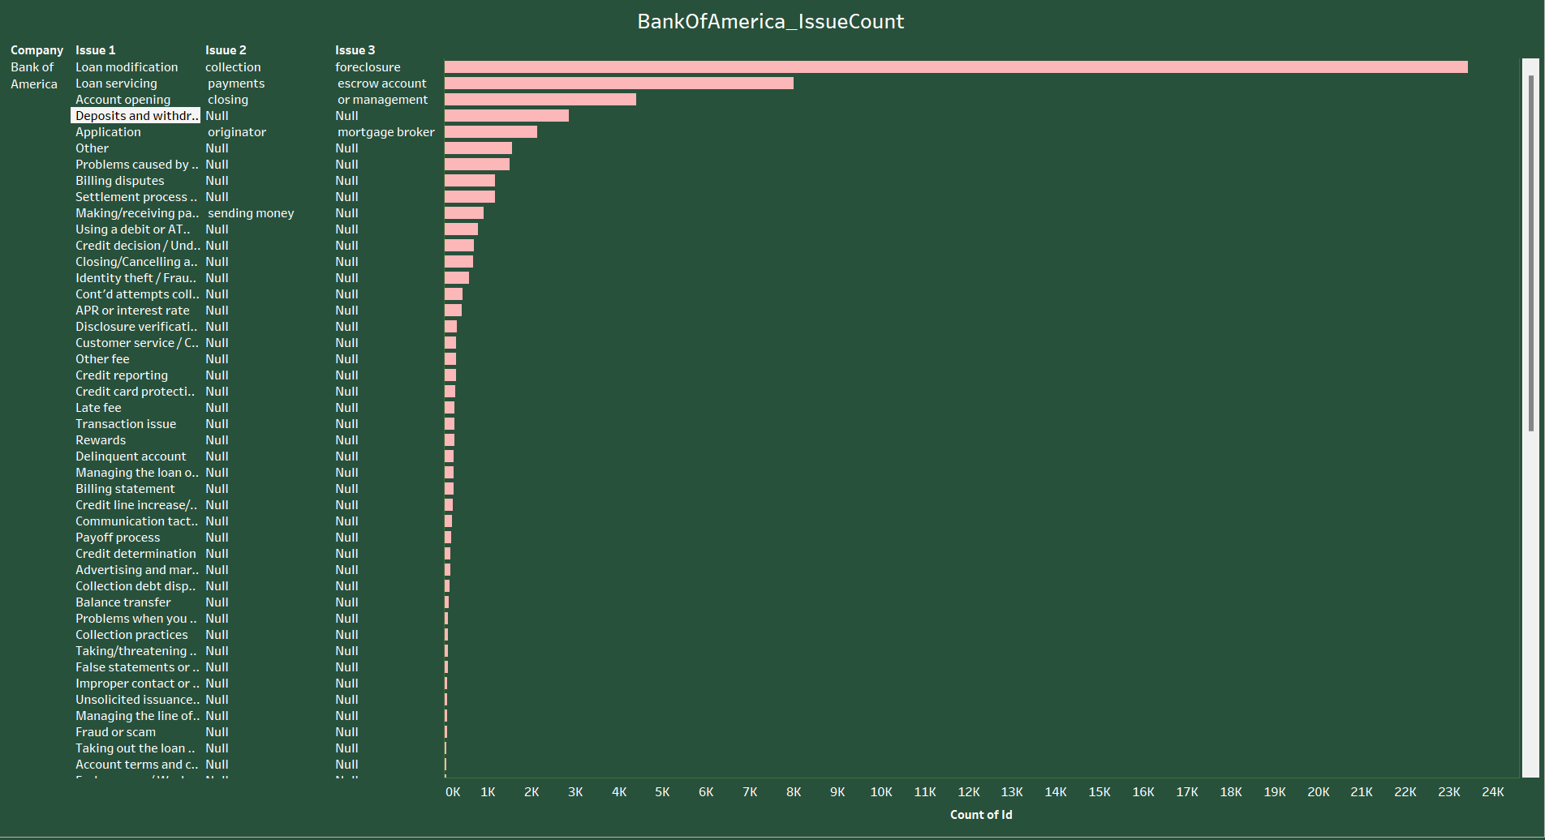
The treemap visualizes the number of issues reported for various companies.
Bank of America has the largest segment, indicating the highest count of issues at 55,998.
Wells Fargo & Company follows with 42,024 issues.
JPMorgan Chase & Co. has 33,881 issues.
Equifax and Experian, credit bureaus, have significant issue counts at 31,828 and 30,905, respectively.
Smaller segments represent companies with fewer reported issues, like U.S. Bancorp and Synchrony Financial with 9,554 and 9,435 issues, respectively.
The size of each segment correlates with the number of complaints received, providing a quick visual comparison between companies

Slide 13

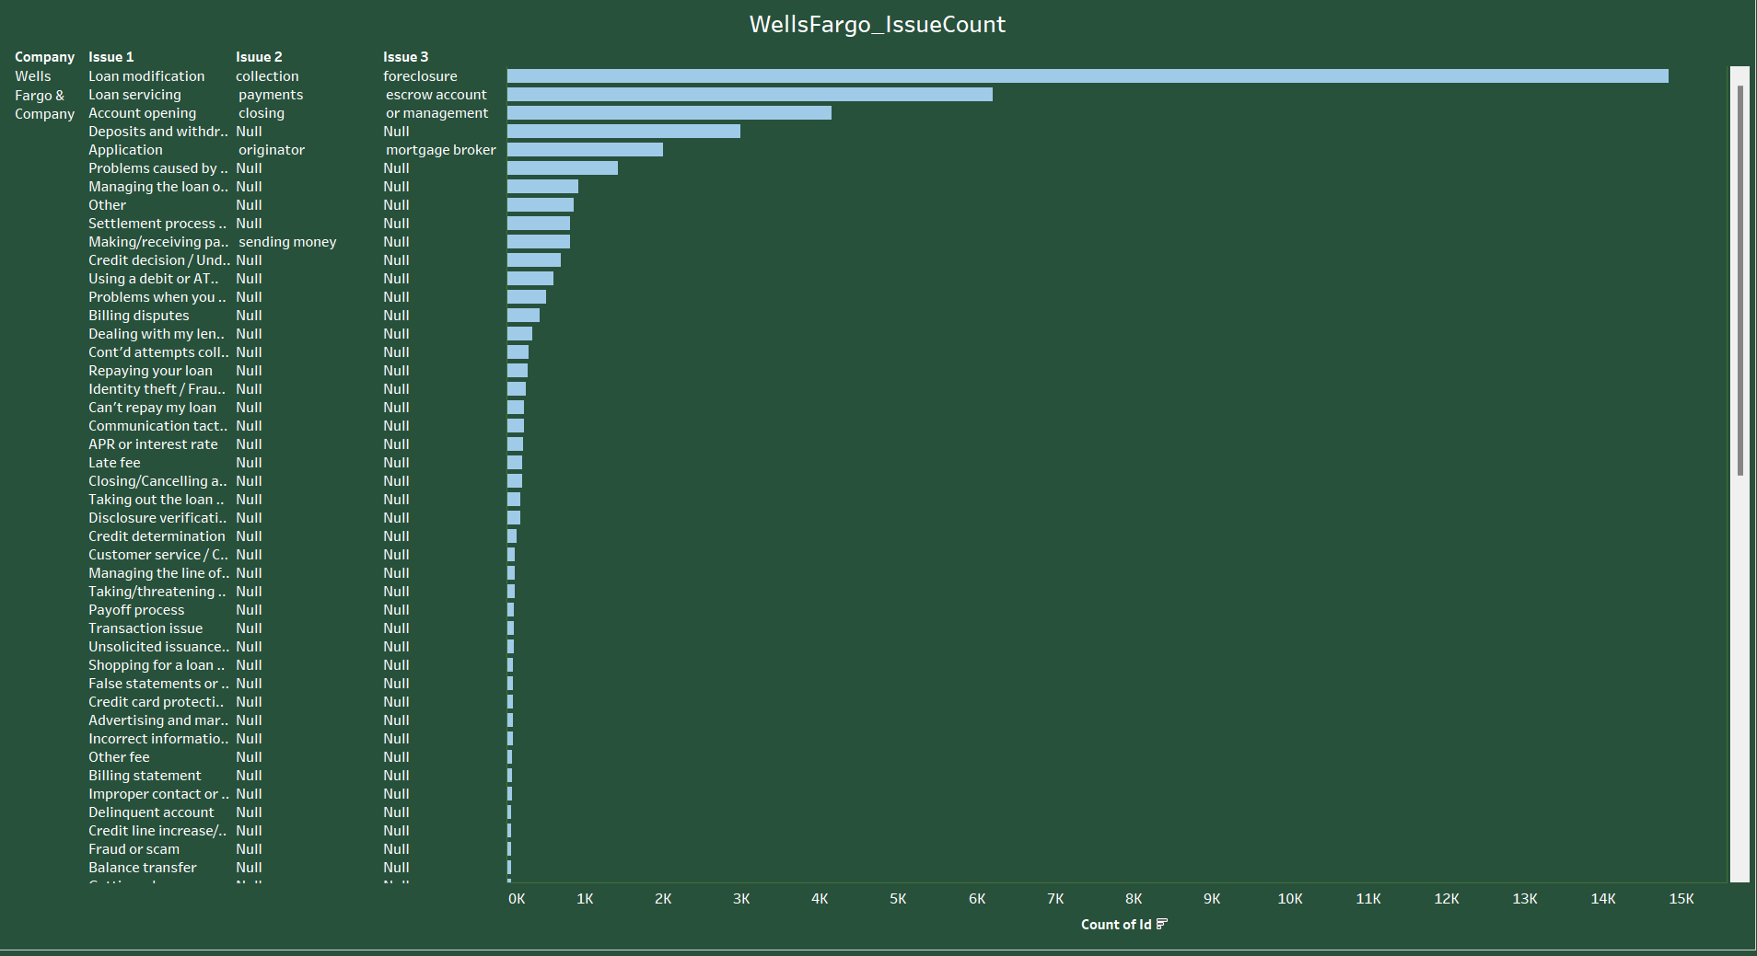
This chart categorizes complaints received by different companies based on the type of product involved:
Bank of America: Most complaints are related to mortgages (36,228), followed by bank accounts or services (10,440).
Wells Fargo & Company: Again, mortgages (25,106) and bank accounts or services (9,966) have the highest complaint counts.
JPMorgan Chase & Co.: Mortgages (16,003) lead, with a substantial number of credit card-related complaints as well (7,803).
Equifax: As a credit bureau, it primarily deals with credit reporting issues (31,694).
Experian: Similar to Equifax, the majority of complaints are about credit reporting (30,768).
The chart indicates that mortgage-related issues dominate consumer complaints for banks, while credit reporting is the main concern for credit bureaus

Slide 14

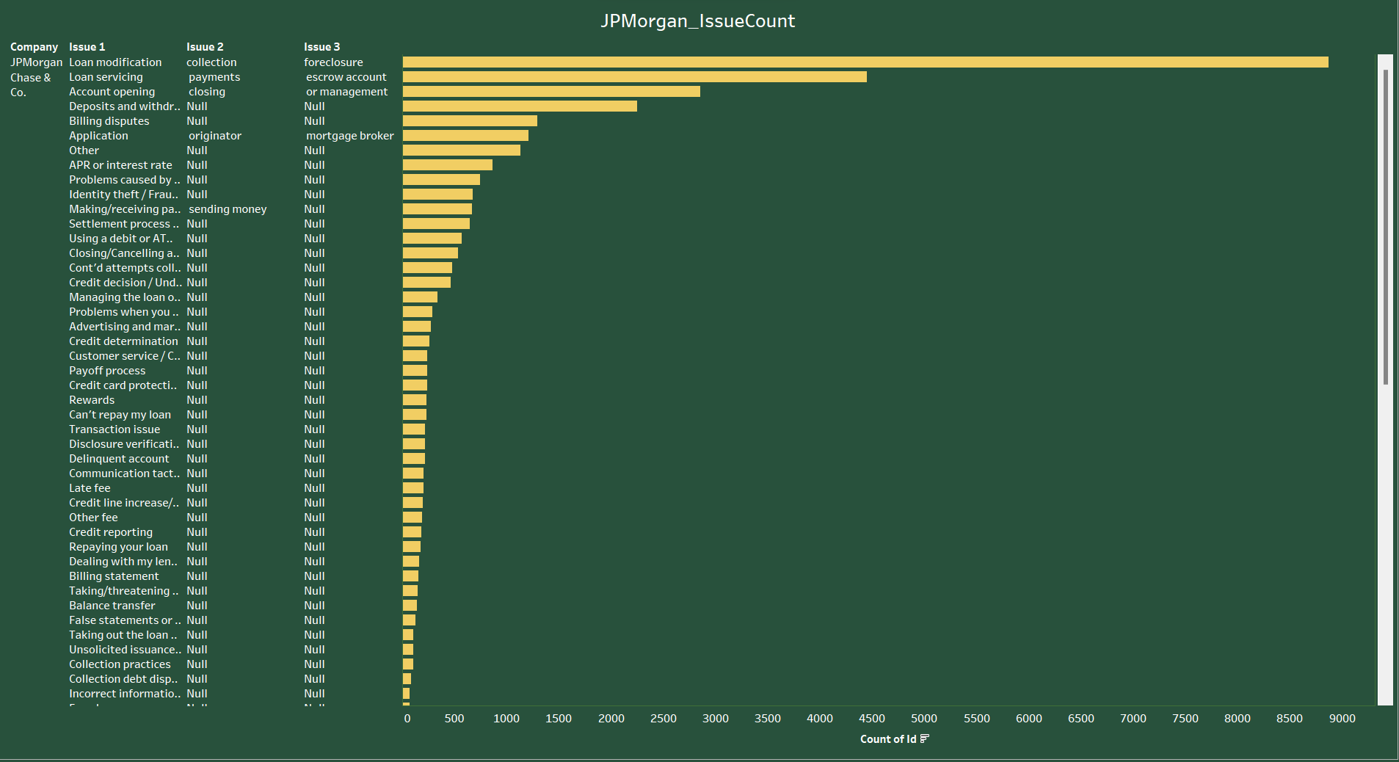
The chart breaks down the number of issues reported for Bank of America across three categories:
Issue 1: The most reported issue is "Loan modification" followed by "Loan servicing" and "Account opening." All other categories in Issue 1 are marked as "Null," which could indicate no complaints or missing data.
Issue 2 and Issue 3: All issues are marked as "Null" except for "Collection payments" in Issue 2, which suggests this is the only category with complaints or data available for reporting in Issue 2 for Bank of America.
The chart emphasizes that the primary concerns for customers of Bank of America revolve around loans, particularly loan modifications and servicing

Slide 15
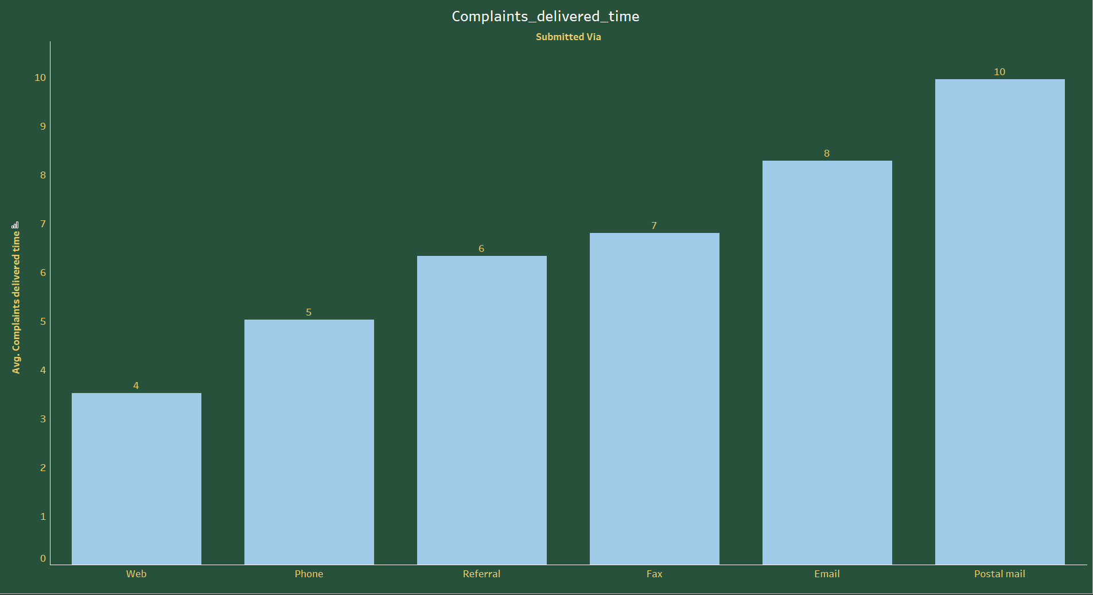
This bar chart presents the counts of various issues reported by customers of Wells Fargo & Company, classified into three main issues:
Issue 1: The most reported issue is "Loan modification" followed by "Loan servicing". Other issues are present but are indicated as "Null", which could suggest no complaints were filed or data for those issues are not provided.
Issue 2 and Issue 3: Similar to "Issue 1", the only category with a non-null count is "Collection payments" in Issue 2. All other categories are marked as "Null".
The data clearly shows that loan-related issues, particularly modifications and servicing, along with collection payments, are the primary concerns for Wells Fargo & Company customers based on the provided dataset

Slide 16

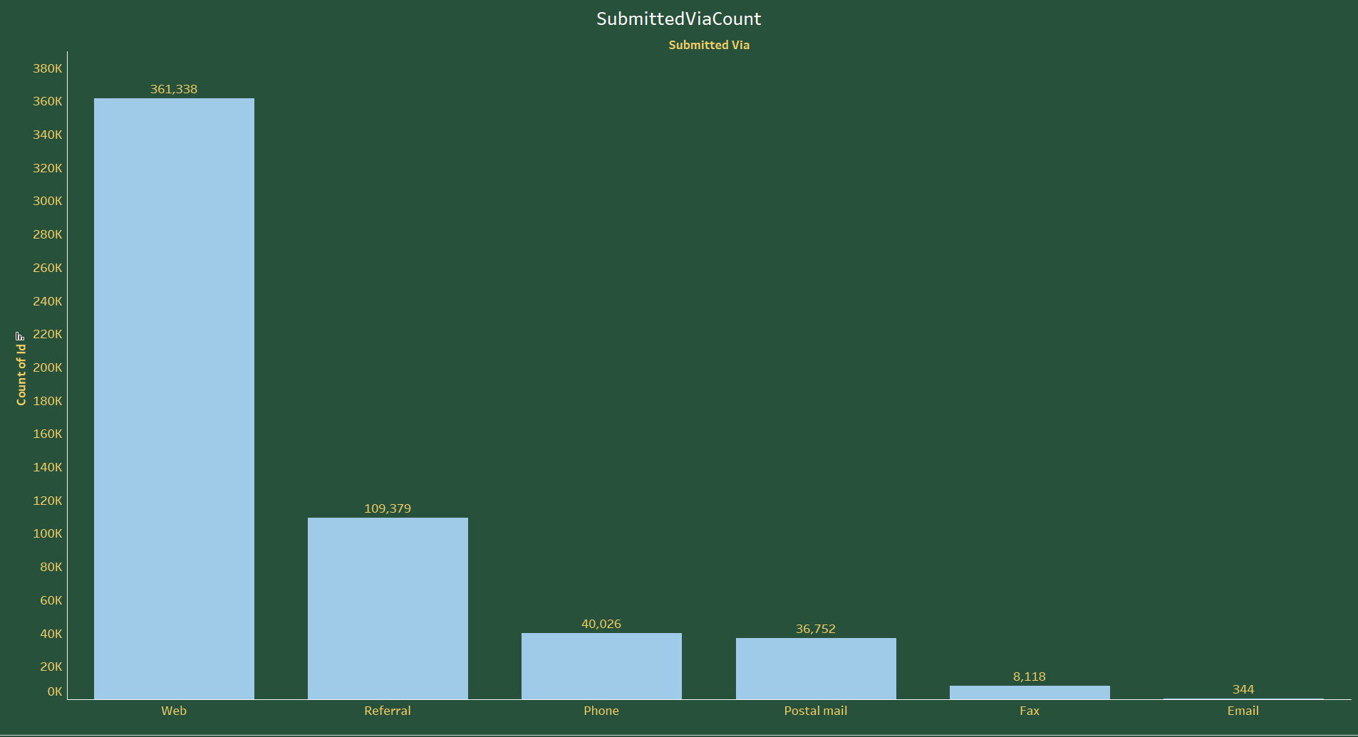
In this bar chart, customer complaints related to JPMorgan Chase & Co. are summarized:
Issue 1: The most reported issue is "Loan modification," followed closely by "Loan servicing."
Issue 2: The highest count is for "Collection payments."
Issue 3: The most complaints are filed under "Foreclosure," followed by "Escrow account" and "or management."
All other categories in Issues 1, 2, and 3 are marked as "Null," indicating no complaints or no data for those particular issues. The data illustrates that the main areas of consumer concern for JPMorgan Chase & Co. are related to loans and debt collection

Slide 17

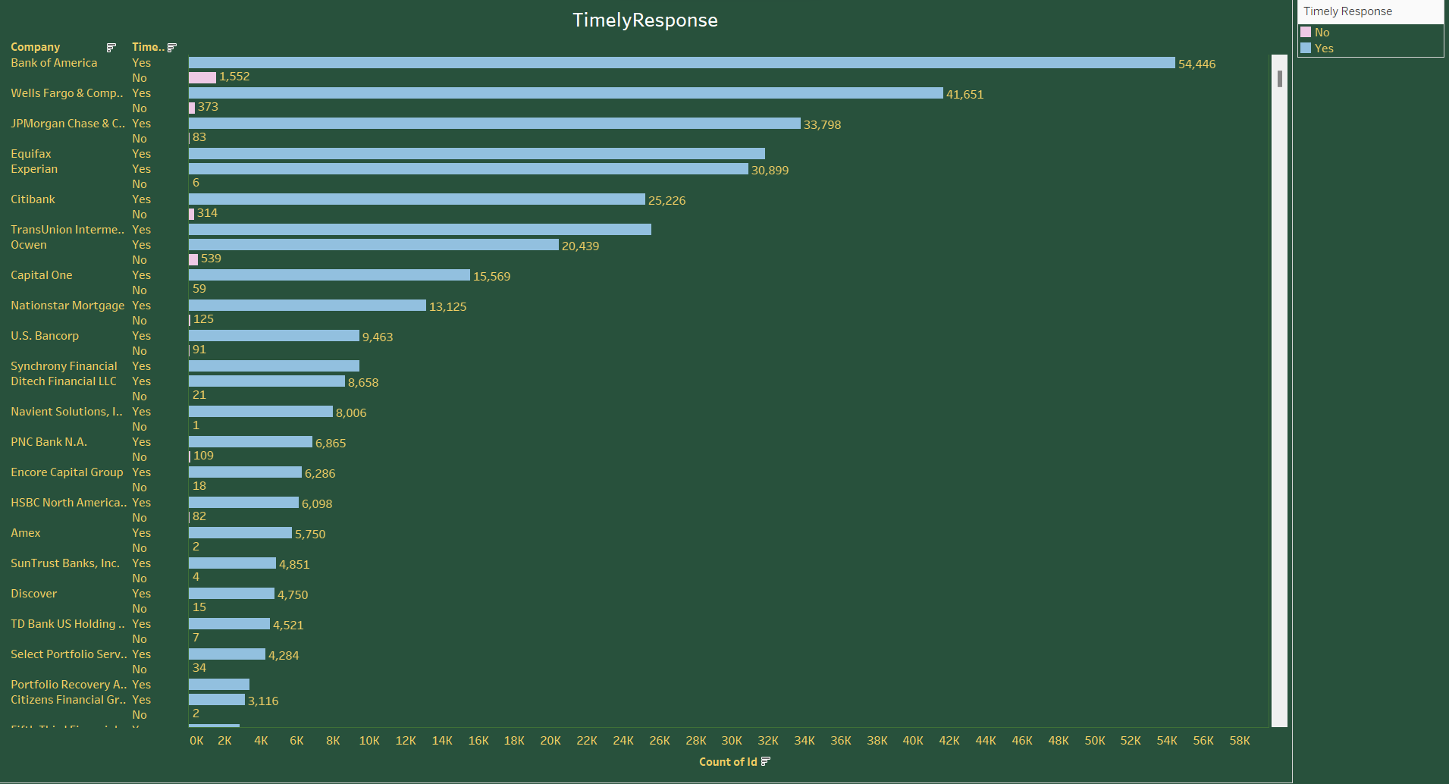
The bar chart shows the average time it takes for complaints to be delivered to the concerned party, based on the submission method:
Web: 4 days
Phone: 5 days
Referral: 6 days
Fax: 7 days
Email: 8 days
Postal mail: 10 days
Complaints submitted via the web are delivered the fastest, while those sent by postal mail take the longest. This information is likely useful for managing expectations regarding the time it takes for a complaint to be processed based on the submission method

Slide 18

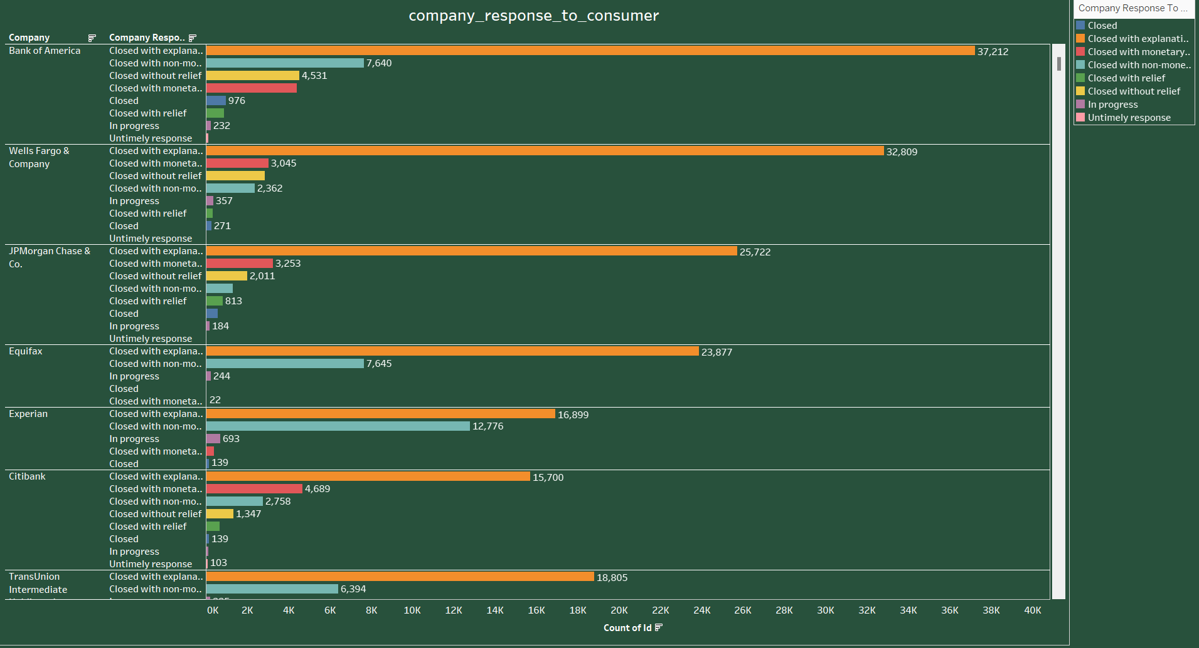
This bar chart displays the count of complaints submitted through different channels:
The web is by far the most common submission method with 361,338 complaints.
Referral follows with 109,379 complaints.
The phone and postal mail are also used, with 40,026 and 36,752 complaints, respectively.
Fax and email are the least used methods for submitting complaints, with 8,118 and 344 complaints, respectively.
The data shows a clear preference for the web as the primary channel for submitting complaints, likely due to its convenience and accessibility

Slide 19

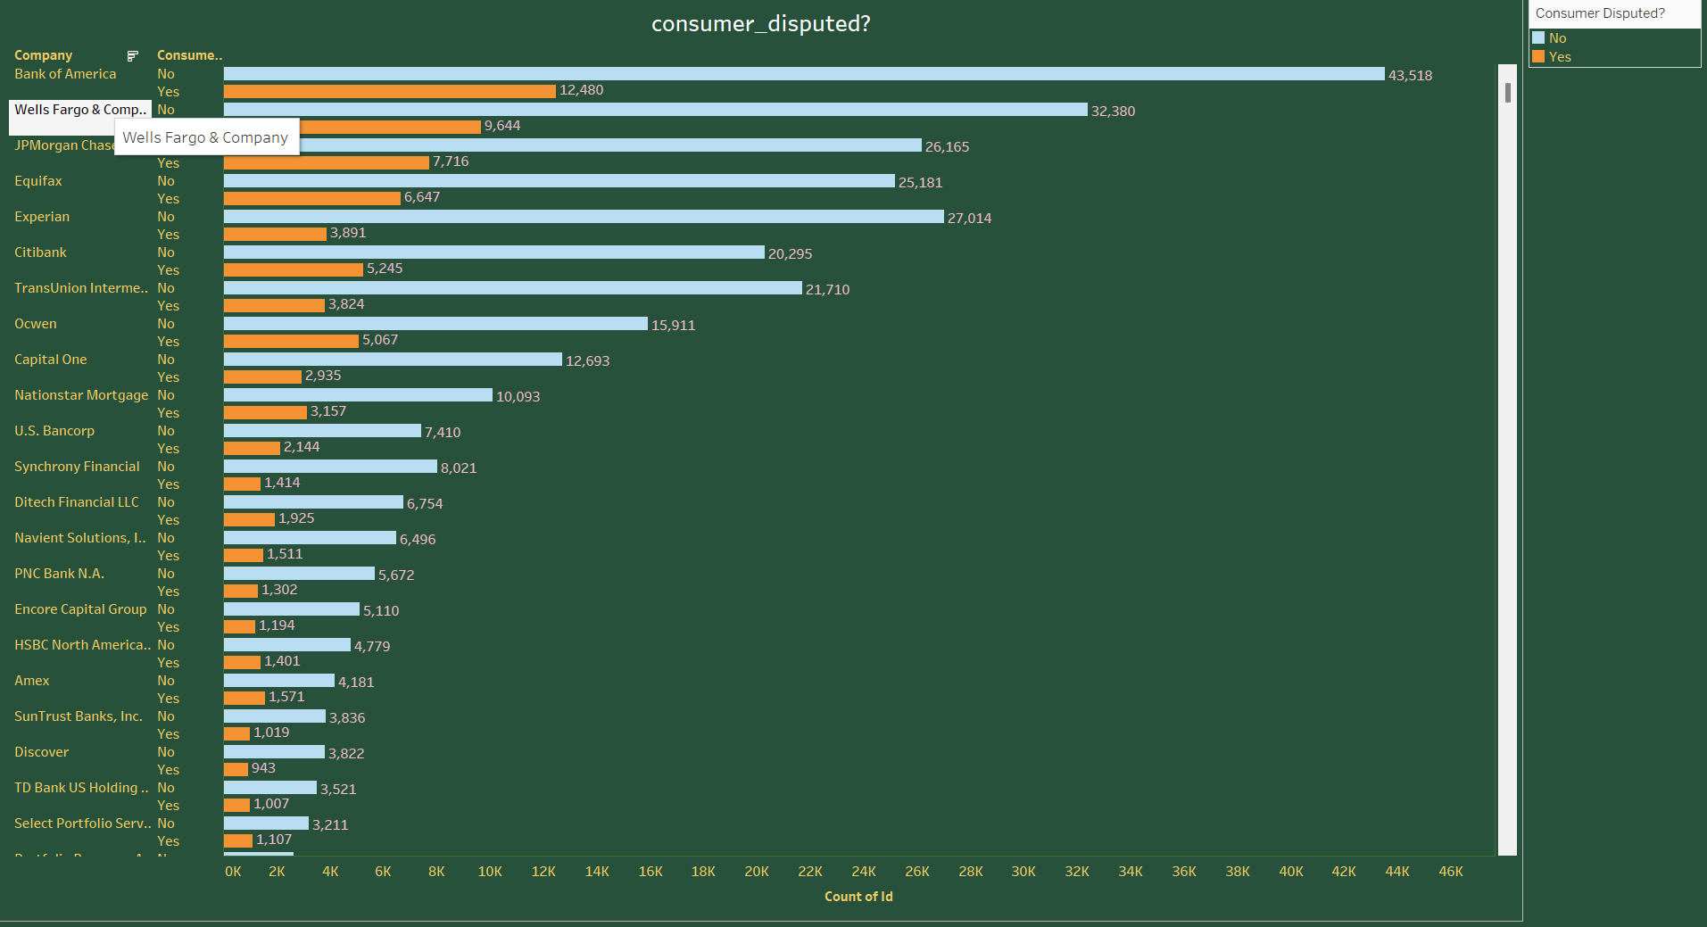
The bar chart illustrates the number of complaints each company responded to in a timely manner, and those they did not:
Bank of America shows the largest number of timely responses (54,446), with a smaller number not responded to on time (1,552).
Wells Fargo & Company also had a significant number of timely responses (41,651) compared to those not timely (373).
JPMorgan Chase & Co. and Equifax both show a higher number of timely responses than untimely ones.
Other companies like Nationstar Mortgage and U.S. Bancorp show a balance between timely and untimely responses.
In general, the chart suggests that most companies do provide a timely response to the majority of complaints received

Slide 20

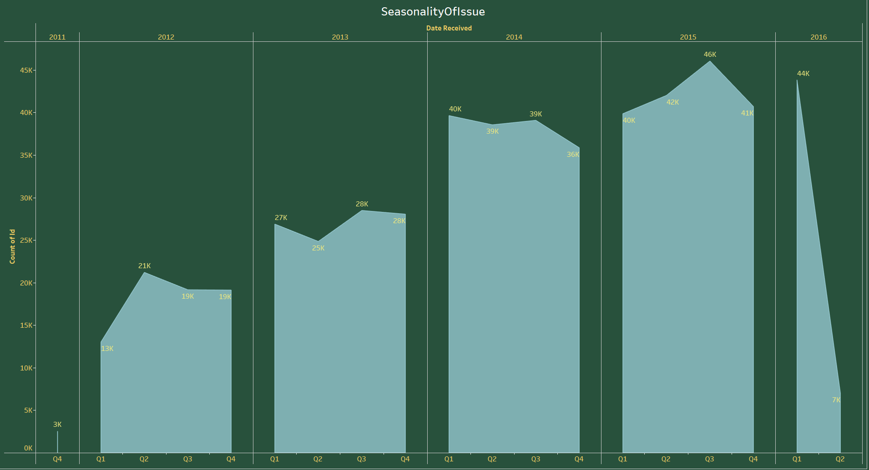
This bar chart shows how various companies responded to consumer complaints:
Bank of America had a high number of complaints closed with explanation (37,212). A smaller number were closed without relief or were still in progress.
Wells Fargo & Company also closed a large number with explanation (32,809), with fewer complaints receiving monetary relief or being left unresolved.
JPMorgan Chase & Co. shows a similar trend, with many complaints closed with explanation (25,722).
Equifax and Experian, two credit bureaus, show many complaints closed with explanation (23,877 and 16,899, respectively).

Slide 21

The bar chart illustrates the number of consumer complaints that were disputed after the company's response:
Bank of America: A large number of complaints were not disputed (43,518), while a smaller number were disputed (12,480).
Wells Fargo & Company: Also had many complaints not disputed (32,380), with fewer disputed (9,644).
JPMorgan Chase & Co.: A significant number of complaints were not disputed (26,165), compared to those that were disputed (7,716).
Equifax and Experian: Showed a notable number of disputes as well, with 27,014 and 25,181 respectively.
Overall, the chart shows that for these companies, a majority of complaints were not disputed by consumers. However, there is still a considerable amount of disputed cases, especially for credit bureaus like Equifax and Experian

Slide 22

The area chart depicts the seasonality of issues reported over several years, quarter by quarter:
There's an upward trend from 2011 (starting at 3K in Q4) to a peak in 2015 (reaching 46K in Q3).
After 2015, there's a sharp decline to 7K in Q2 of 2016.
The peak in each year seems to occur in the third quarter, suggesting a seasonal pattern in complaint volume.
This trend could be influenced by various factors, such as economic changes, company policies, or consumer awareness campaigns that may lead to increased reporting in certain periods. The drop in 2016 could indicate a change in how issues are reported or resolved, or perhaps a reduction in the number of issues experienced by consumers.

Slide 23
Code

Slide 24

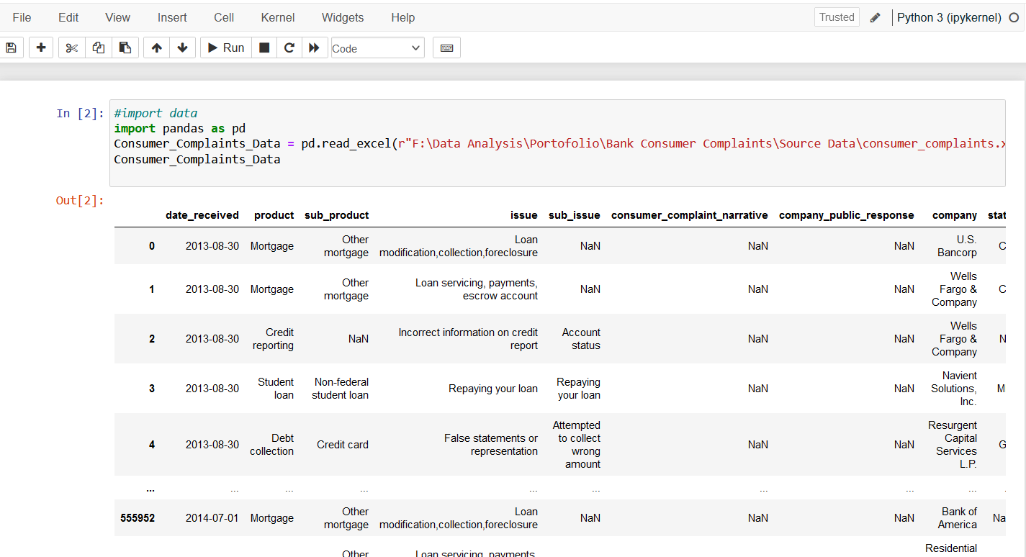
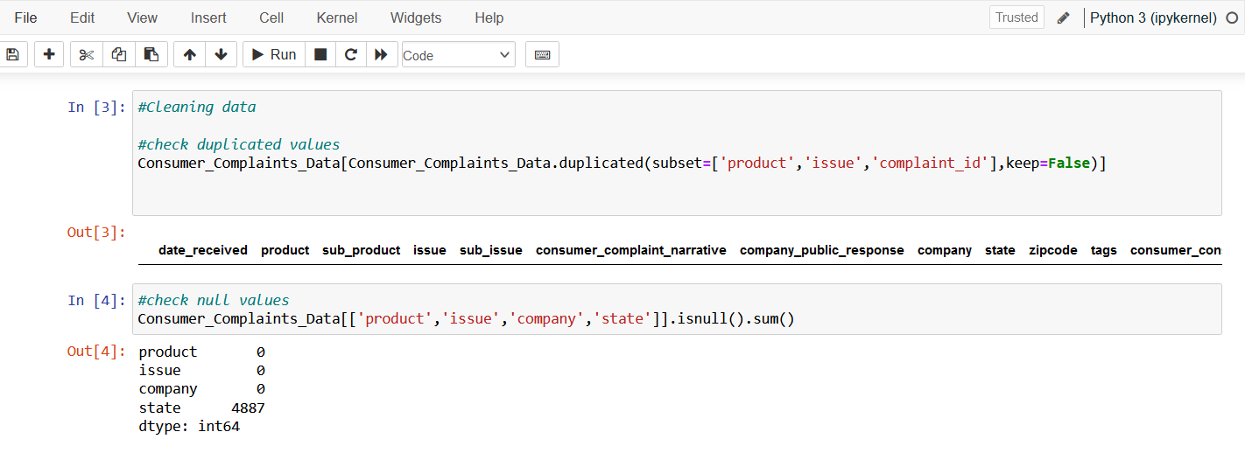
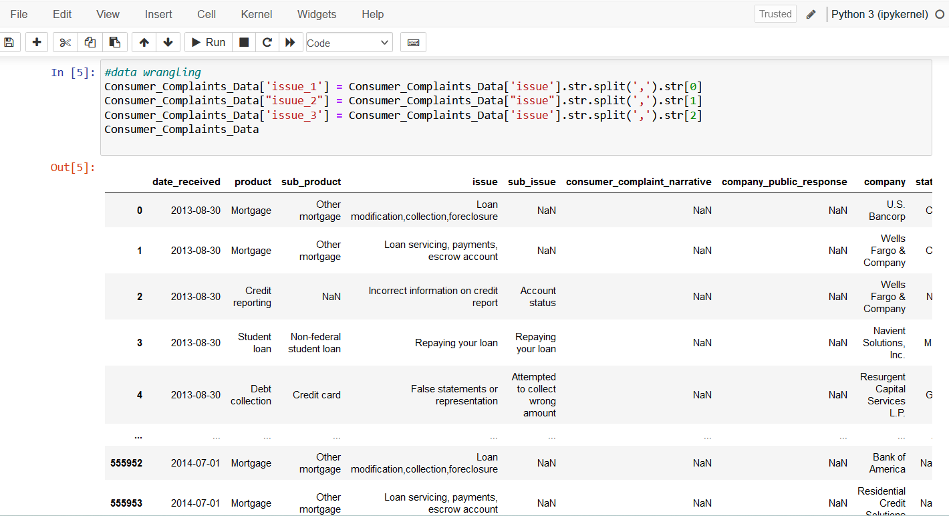
The code is loading a dataset of bank consumer complaints from an Excel file into a Pandas DataFrame and displaying its contents. The DataFrame Consumer_Complaints_Data will hold the entire dataset which can then be used for further analysis, such as identifying the number of complaints per company, the distribution of issues, or trends over time. This is typically an initial step in data analysis projects to inspect the data before conducting more detailed analysis or preprocessing

Slide 25

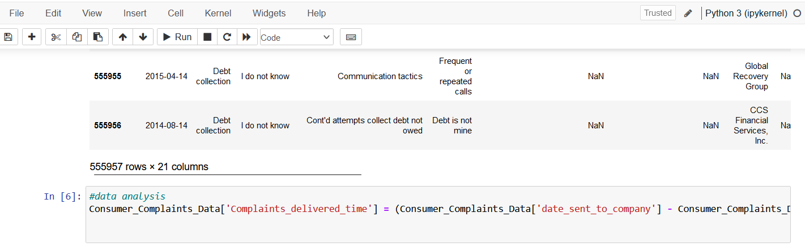
This snippet contains two separate data cleaning steps for the Consumer_Complaints_Data DataFrame:
Checking for Duplicates: The first line checks for duplicate rows based on the product, issue, and complaint_id columns. It will return a DataFrame with all the entries that are duplicates. This is used to identify records that have been reported more than once.
Checking for Null Values: The second line checks for null (missing) values in the product, issue, company, and state columns. It sums up the number of null values in each of these columns, which is helpful to assess data completeness and identify if any data imputation or removal is necessary.
Together, these steps are crucial for understanding the quality of the data before conducting any further analysis, as duplicates and missing values can significantly affect the results

Slide 26

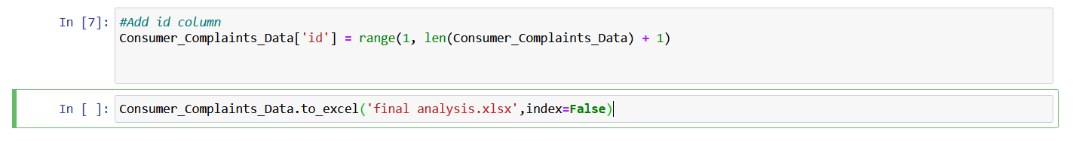
The provided code snippet is performing data wrangling on the Consumer_Complaints_Data DataFrame:
It adds a new column issue_1, which contains the first element from the issue column, based on a split by commas.
A typo exists in the second line, it should be issue_2 instead of isuue_2. It's intended to create a new column issue_2 with the second element from the issue column.
It adds another new column issue_3, which contains the third element from the issue column.
The purpose here is to break down the issues into separate columns for easier analysis of individual issue components

Slide 27

In this line of code, you're creating a new column in the Consumer_Complaints_Data DataFrame called Complaints_delivered_time. This column will calculate the number of days it took for each complaint to be delivered to the company, by subtracting the date_received from the date_sent_to_company. The .dt.days accessor is used to get the number of days from the resulting Timedelta object.
This new column can then be used for further analysis, such as determining the average time it takes for complaints to be acknowledged by companies, or identifying whether there are any significant delays that could be addressed to improve customer satisfaction

Slide 28
This line of code adds a new column named id to the Consumer_Complaints_Data DataFrame. The id column is populated with a sequence of integers starting from 1 up to the number of rows in the DataFrame. This creates a unique identifier for each row, which can be helpful for indexing, joining with other data sets, or simply to have a unique reference for each complaint. The range function is used in combination with len(Consumer_Complaints_Data) to generate this sequence of numbers

Slide 29

Conclusion
Initial analysis indicates that the bulk of the complaints are related to mortgages and loan servicing, with a substantial number being resolved with explanations provided by the financial institutions. Most companies appear to respond in a timely manner, although there are cases where disputes arise post-resolution. Seasonality may affect complaint volumes, peaking in the third quarter of the year, and declining towards the end of the analyzed period. The addition of an ID column suggests future work may include individual complaint tracking or further detailed analysis. This project lays the groundwork for targeted improvements in consumer financial protection and company response practices

